Slide 1
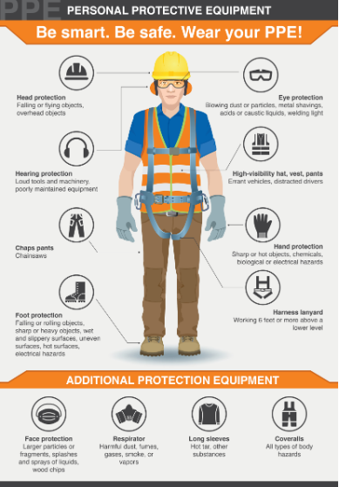
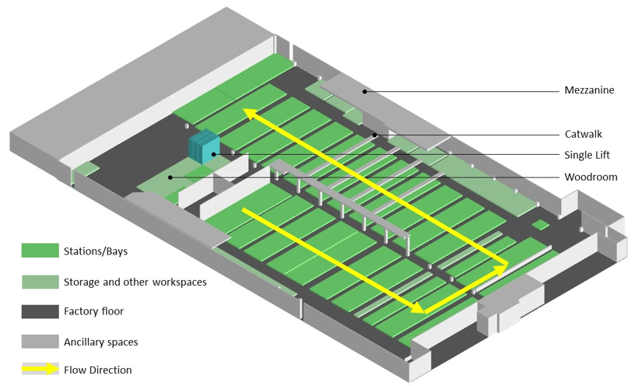
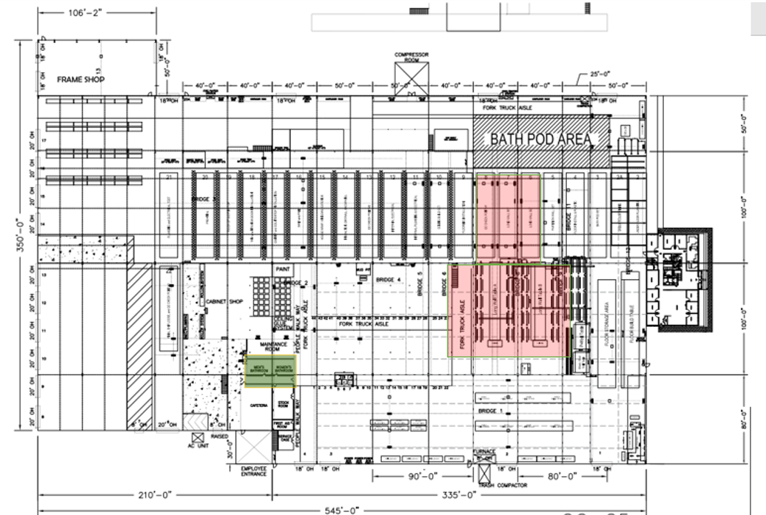
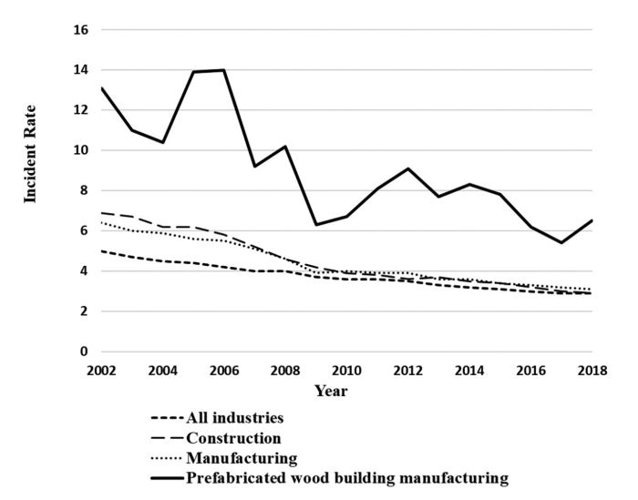
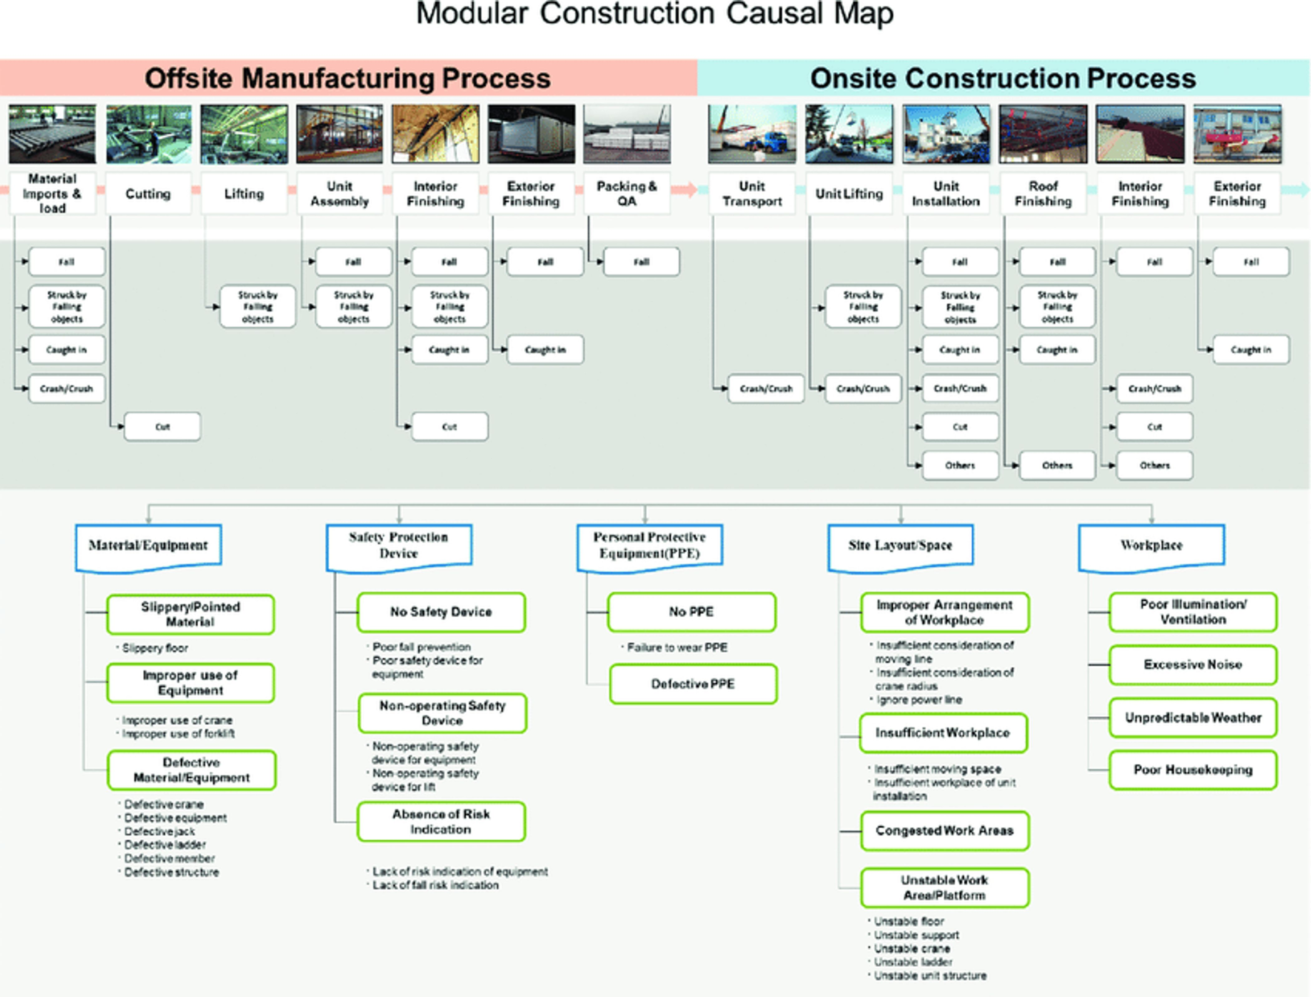
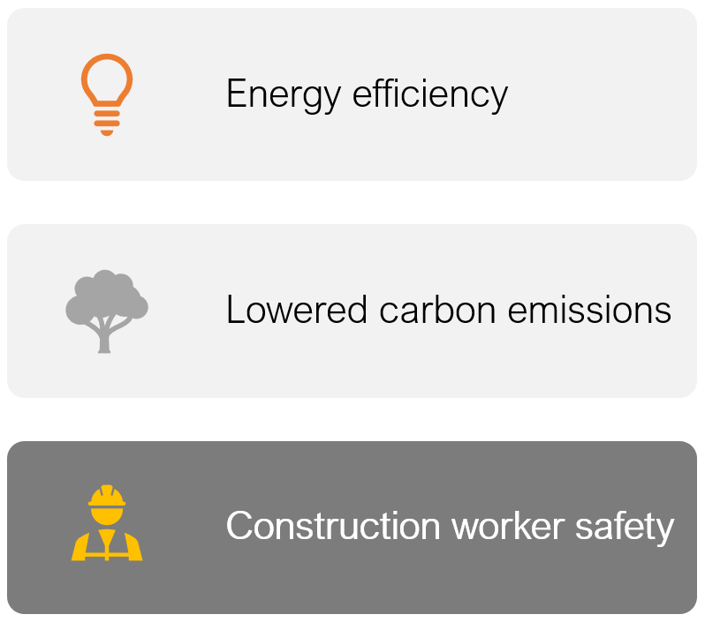
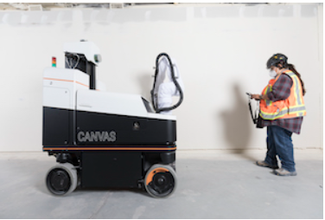
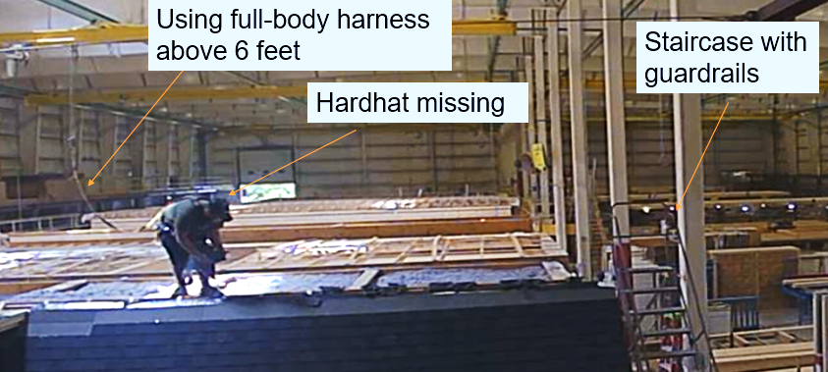
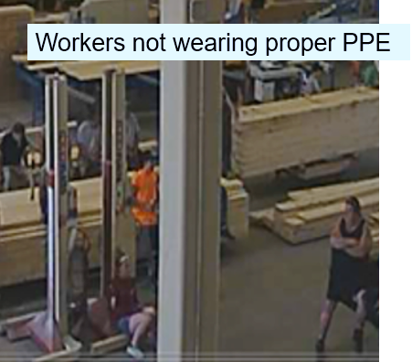
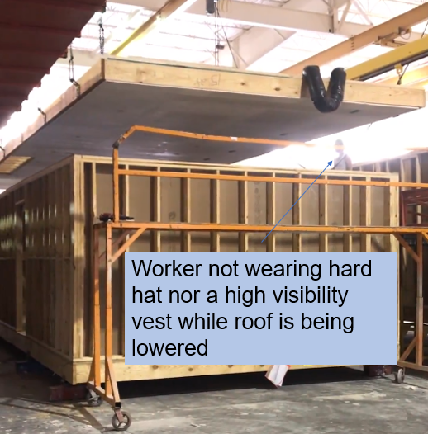
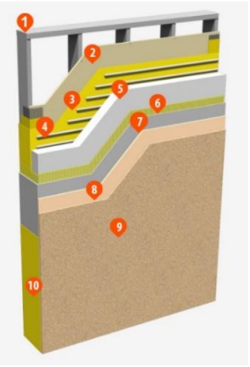
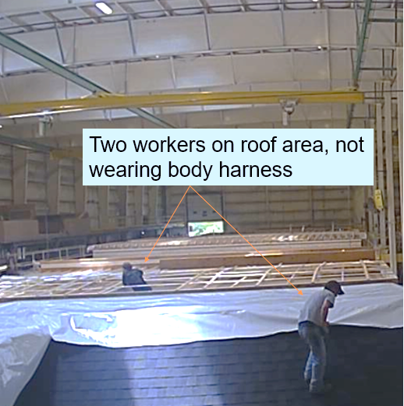
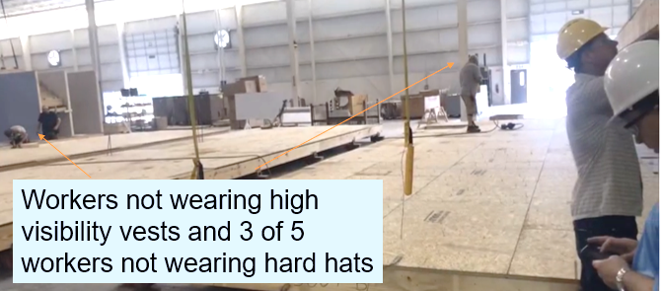
Enhancing Worker Safety during Off-Site Construction of Energy-efficient, Low-carbon
Exterior Envelope
1
2
Nanette Giron, Ankur Podder The University of Texas at El Paso, National Renewable Energy Laboratory
1
2
INTRODUCTION
Method: Literature review and observation studies of two off-site factories
RESULTS
CONCLUSION
The construction industry is not doing enough to embrace off-site modular construction. It is a missed opportunity for optimized energy efficiency because prefabricated exterior wall envelopes are lower in cost and faster and easier to install. Factory off-site construction offers improved safety for construction workers because work is done in a controlled environment, but lack of intent, understanding, and data is also a missed opportunity for enhancing worker safety. My research looks specifically at the prefabricated wall exterior envelope in the context of safety.
Safety comparison findings in prefabricated
and modular construction
Solutions to decrease accidents in off-site prefabricated construction
8
1- 2
Modular and prefabricated construction are perceived to be safer, but the accident rates are much higher than in the general construction and manufacturing industries.
Source: Gilsu, Jeong, et al. (2022) Analysis of safety risk factors of modular construction to identify accident trends, Journal of Asian Architecture and Building Engineering, 21:3, 1040-1052. https://www.tandfonline.com/doi/full/10.1080/13467581.2021.1877141
Safety training for workers
Provide movable kiosks with PPE at workstations
Ensure tools are well-maintained
Place safety posters in visible locations
3
Factory workflow layout
(Vermont factory)
Factory layout plans
(North Carolina factory)
Research Question:
Off-site factories build with ease of energy efficiency and lowered carbon emissions, but is the process safer?
Source: Images by NREL staff, Dr. Naveen Kumar Muthumanickam and Shanti Pless
Source:http://www.mnltap.umn.edu/publications/exchange/2018/December/personal/
Additional Safety Measures
Outcome
The incidence rates represent the number of injuries per 100
full-time equivalent workers
Need for specialized safety management
Assist safety managers to understand safety risk factors and make prompt safety decisions
Predict probability of accidents
Develop strategy to reduce accidents
Prioritize risk factors
Control unsafe conditions
Use of automated machinery
Motivation: Encourage prefabricated wall envelope in factory vs. site construction
Predict and mitigate workforce safety concerns during construction of energy-efficient, low-carbon exterior envelope
Workforce safety evaluation framework for modular builders and prefabricators to follow
4
Canvas Robotic Drywall Finishing Tool
Ease of energy efficiency integration
Eliminates:
Fall risks working at elevated heights
Exposure to airborne particulates
Strenuous repetitive motions
Reduced construction time
Higher quality control
Cost savings
Smaller, lighter install equipment and machinery
Insulation technology – effective moisture barrier
5
Lowered carbon emissions
Cuts down on waste from construction process by making better use of materials
Buy material at exact lengths, avoid overbuying
Decrease vehicular transportation to and from construction site
FUTURE WORK
BACKGROUND
Source: Gilsu, Jeong, et al. (2022) Analysis of safety risk factors of modular construction to identify accident trends, Journal of Asian Architecture and Building Engineering, 21:3, 1040-1052. https://www.tandfonline.com/doi/full/10.1080/13467581.2021.1877141
How can improved worker safety increase worker productivity? Research the correlation between these two.
Pilot demonstration
Work with factory designer for new modular layout for worker safety, i.e., easy access to PPE kiosks
Work closely with OSHA so that they take notice of this safety niche
Audits or inspections by OSHA
Develop new training models under OSHA, specific to modular factories
Provide video trainings
Require certification of factory safety
Prefabricated wall exterior envelope
Factory observational findings
6
Exterior Insulation and Finish System (EIFS)
Construction worker safety
Highly skilled tradesmen
Fewer workers leads to decreased accidents
Easy access to wear appropriate safety equipment
Provide high-quality, well-maintained tools
Avoid injuries due to heavy lifting
No scaffolding needed in a factory
Work is elevated to optimal working height – avoids injuries or mistakes caused by kneeling or bending
Fixed, directional task lighting eliminates shadows and maintain precise tolerances
Work takes place in a fully enclosed, well lit, weather protected factory
Work in progress moves from one station to next via roller conveyors
Automation of assembly line
Improved working conditions
Improved productivity and safety performance
9
Metal framing
Substrate
Wall proofing
Adhesive
Foam insulation
Mesh
Base coat
Primer
Finished texture
Water proofing
Source: Photos by NREL staff, Dr. Naveen Kumar Muthumanickam and Shanti Pless
REFERENCES
Correia Lopes, Goncalo, et al. "A Systematic Review of Prefabricated Enclosure Wall Panel Systems: Focus on Technology Driven for Performance Requirements." Sustainable Cities and Society 40 (2018): 688-703. Web.
Jamshidzadeh, Amin. “Evaluation of Efficiency Modular High-Rise Buildings with Multiple Case Study.” International Journal of Applied Sciences: Current and Future Research Trends (May 27, 2022): Vol. 14 No. 1.
Kwon, Hyang. “Worker Safety and Health Labor Practices in Sustainable Residential Buildings.” S.U.N.Y. Fashion Institute of Technology (May 2013).
https://buildsmartna.com/products/#i-wall-system
Cuellar Lobo, Jose Daniel, Zhen Lei, Hexu Liu, Hong Xian Li, and SangHyeok Han. “Building Information Modelling- (BIM-) Based Generative Design for Drywall Installation Planning in Prefabricated Construction.” Advances in Civil Engineering 2021 (July 14, 2021): e6638236. https://doi.org/10.1155/2021/6638236.
Build SMART Products Page (buildsmartna.com)
Tamayo, Edgar, et al. “Automation of a Steel Wall Framing Assembly.” Resilient Structures and Sustainable Construction (2017).
https://osha-safety-training.net/osha-slips-trips-falls-protect-employees/
Gambatese, J.A., Behm, M. and Hinze, J.W. (2005) Viability of Designing for Construction Worker Safety. Journal of Construction Engineering and Management, 131, 1029-1036.https://doi.org/10.1061/(ASCE)0733-9364(2005)131:9(1029)
7
Source: https://www.stocorp.com/prefabricated-wall-panels/
Acknowledgements: This internship was funded by NREL Student Training in Applied Research (STAR) program, University Partnerships Program, and Wells Fargo Bank, all of whom I am very grateful to. I want to thank my mentor Ankur Podder for his generous support and guidance in this project including his time, expertise, and resources. I also appreciate the assistance of Dr. Naveen Kumar Muthumanickman for his patience in explaining current projects and making me feel as a part of the team. Thank you, Dr. Ellen Morris, Nadia Auch, Cat Dolezal, Darylann Aragon, and Bettina Ankhurst, for your amazing support and encouragement throughout this internship and making such wonderful and fun experiences, along with my STAR cohort and other interns I met this summer. Thank you also to Michael Deru, Juan Torres, Ismael Mendoza, Gokulram Paranjothi, Judith Vidal, Steve Granda, Deanna Shattuck, and Becky Wall for your kindness and making me feel welcome at NREL. I would also like to thank my university mentor, Dr. Adeeba Raheem for having selected me for this internship. I look forward to my future research collaboration with Dr. Raheem and Ankur Podder.
NREL STAR Intern Symposium
Golden, CO
August 4, 2022

